Slide 1
Software Architecture and Design I SOEN 343 Instructor: Dr. Rodrigo Morales https://moar82.github.io/ rodrigo.moralesalvarado@concordia.ca
Lecture 2a: Models for Software Architecture
Notes:
1

Slide 2
Objectives
• Introduce concepts of the view models of software architecture
Discuss the UML notations as modeling tools for software architecture specification
Introduce UML Static and behavioral diagrams
Introduce the concept of architectural models
Introduce the 4+1 Model

Slide 3
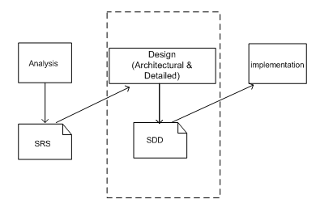
A simplified software development life cycle
Notes:
Software design is an early phase of the Software Development Life Cycle (SDLC)
During this phase, software designers model the system and assess its quality so that improvements may be made before the software goes into the production phase
SDLC consists of the following stages: software requirements analysis, software design (architecture and detailed); software development and implementation; and testing and quality assurance, maintenance and evolution
The dashed box depicts the scope of software design
The software requirements specification (SRS) provides the input necessary for the design.
SRS is the result of requirements analysis; it records the functional and nonfunctional requirements that must be met by the software system
What is the outcome of the software architecture design? In a few words is an overall representation of the software to be built

Slide 4

Software architect tasks
Specify at high-level of abstraction a software system by employing decomposition, composition, architectural styles and quality attributes
Notes:
Software architecture specifies a high-level of abstraction of a software system by employing decomposition, composition, architectural styles, and quality attributes.
Every software architecture must describe the collection of software components and the connections and interactions between these components.
It must also specify the deployment configuration of all components and connections. Additionally, a software architectural design must conform to the functional and non-functional requirements of the software project.

Slide 5
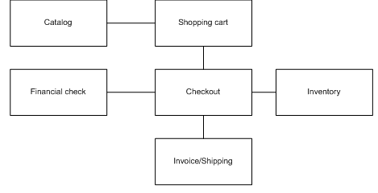
Example
Notes:
There are many effective ways to describe the software architecture formally or informally.
Box-and-line diagrams are the simplest way to describe business concepts and processes during the analysis phase of the software development lifecycle.
The figure shown in this slide presents a box-and-line diagram for an on-line shopping business where customer browse the catalog and put the selected items in shopping cart.
After customers check out, the system examines customers’ credit record, updates the inventory, and notifies the shipping department to process the order

Slide 6
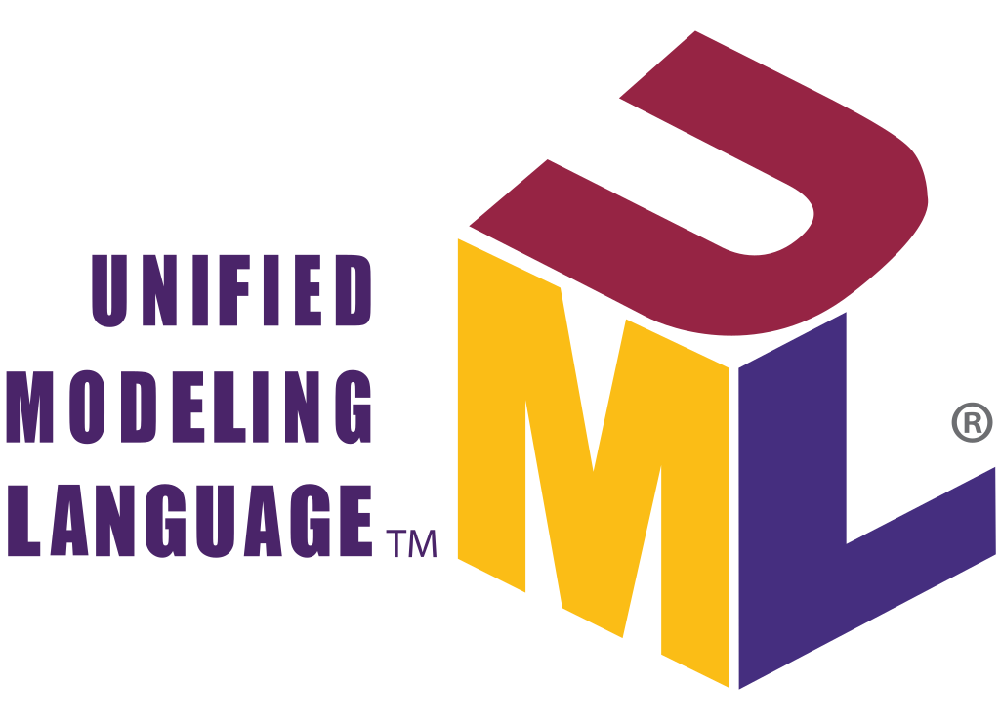
UML for Software Architecture
UML is a graphical language for visualizing and documenting the artifacts of a software-intensive system
UML offers a standard way to draw a system’s blueprints
It is based on OO analysis and design
Notes:
As OMG states that “the Unified Modeling Language (UML) is a graphical language for visualizing, specifying, constructing, and documenting the artifacts of a software-intensive system.”
UML offers a standard way to draw a system’s blueprints, including conceptual notions such as business processes and system functions as well as concrete designs such as programming language statements, database schemas, and reusable software components.
UML is a typical OO analysis and design notational tool that provides many useful diagrams that can be used to map requirement specifications to architectural designs and from these to coding.
UML provides several modeling diagrams that can be grouped into two major categories: Structural (static) and Behavioral (dynamic).

Slide 7
UML (static) structural diagrams
Class
Object
Composite structure
Component
Package
Deployment

Slide 8
UML Behavioral (dynamic) diagrams
Use case
Activity
State Machine
Sequence
Interaction Overview
Communication
Time Sequence

Slide 9
UML (static) structural diagrams

Slide 10
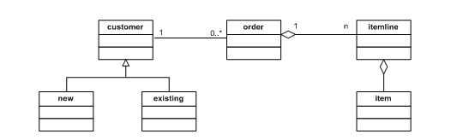
Class Diagram
Notes:
This diagram provides a static view of the system. It captures the vocabulary of the designed system.
It is the foundation diagram of the system design and it is the most frequently used UML diagram as well.
Class diagrams can be derived from use case diagrams or derived from text analysis on the given problem domain.
A class diagram is generated by system analysts and system designers and will be iteratively refined in the subsequent phases during the software development life cycle.

Slide 11
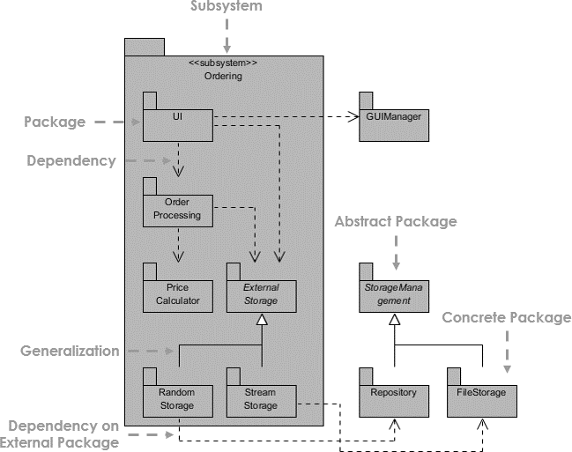
Package Diagram
https://www.visual-paradigm.com/guide/uml-unified-modeling-language/what-is-package-diagram/
Notes:
A package is represented by a tabbed folder that indicates where all included classes and sub packages reside.
Packages play a similar role as a directory for grouping files in a file system; they allow the organization of all closely related classes in a well-formed manner to be placed in one “container.”
For example, namespace in .NET and packages in Java provide well-formed structure for class accessibility and class correlations.
We can organize functionally related classes in the same package so that these classes can access each other within a default accessibility or visibility.
We can also organize related packages in a same parent package to build a class and package hierarchy just like.NET class library and Java API.
Another reason for using the package organization is namespace sharing; in this way, all classes in the same package have a unique name but they may have same name in different packaged (namespaces).
A package diagram shows the dependency relationship between packages (see static structure above), where a change of one package may result in changes of other package due to this dependency.
The package diagram may also specify the contents of a package, i.e., the classes which constitute a package and their relationship.
The use of package diagrams to represent system structure can help reduce the dependency complexity and simplify relationships between groups of classes.

Slide 12
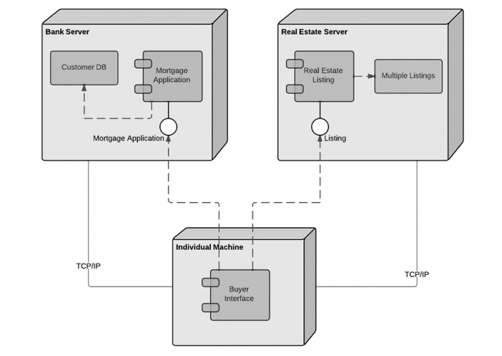
Deployment Diagram
https://www.lucidchart.com/pages/uml-deployment-diagram
Notes:
Deployment diagrams depict the physical configuration of the software system deployed on hardware server nodes and the network between the nodes (defined as protocols).
This diagram is generated in the later phase of software development life cycle.
All components in the system need to be deployed on servers to provide services via network protocols.
Component diagrams are the basis for the deployment diagram.
UML uses a cube symbol to represent a computing resource node; such a resource can be a hardware device or a deployed software subsystem.
For example, data server, Web server, and application server can be nodes and hence described by cubes in a deployment diagram.
The link between nodes is the network connection depicted by the network protocol.
The deployment diagram is widely used to model and design distributed software systems.

Slide 13
Behavioral Diagrams

Slide 14
Use Case Diagram
Notes:
Use case diagrams describe user requirements in terms of system functionality (use cases) as a contract between the user (actors) and the software system.
It consists of actors, use cases and links between them.
An example of use case is shown here
An actor in a use case diagram is an external “user;” this may be a human end user, an application, an external device, or another system.
Each use case is a meaningful operational work scenario.
That is, use cases are scenario-oriented in the sense that each is a sequence of working steps to be carried out by classes in order to provide the required system functionality.
The detailed steps are specified in a separate note including the pre and post conditions of the action in the sequence.
The (simple) connection link from actor to use case shows the direction of actors using the use case.
An <<include>> link, a special kind of link, from one use case to another indicates that the first use case reuses or includes the latter use case and it is needed to complete the work to fulfill the requirement.
The <<include>> link is a dashed line with an arrow pointing to the reused use case.
An <<extend>> link, another special link, shows a newly created optional use case from an existing use case.
It covers alternative cases that may or may not necessarily take place.
An <<extend>> link is also a dashed directed line with an arrow towards the extended use case; these special links are labeled accordingly.

Slide 15
Activity Diagram
Notes:
An activity diagram is used to describe complex business processes; they typically involve complex workflow, decision making, concurrent executions, exception handling, process termination, etc.
This is a workflow-oriented diagram describing steps on a single process.
One activity diagram corresponds to one business process.
There are many activities in a business process.
The activity diagram explores the activity dependency within the business process.

Slide 16
Sequence Diagram
Notes:
Sequence diagram is one of the most important and most widely used UML diagrams for software system analysis and design.
It is a time-oriented interaction diagram showing the chronological sequence of messages between objects.
Usually, one sequence diagram corresponds to one use case.
Each participant object in this diagram has a vertical timeline for its life cycle.
Time goes forward along with the timeline downward.
Each vertical timeline has a number of narrow rectangle boxes (called activations) representing the object activated state where either it receives messages or sends out messages.
Each activation box may also have a self-recursive directed link pointed back to itself, indicating the object passes messages to itself.
A message passing action between objects is represented by a horizontal arrow link from the source to the destination.
A simple transfer message line just transfers control from one object to the other.
It is represented by a solid line with an arrowhead.

Slide 17
Architecture View Models

Slide 18
Architecture View Models
A model is a simplified description of a system from a particular perspective
There is no single view that can present all aspects of complex software to stakeholders
Specific views models provide partial representations of the software architecture to a specific stakeholder:
system users, the analyst/designer, the developers, the system integrator, etc.
Notes:
A model is a complete, simplified description of a system from a particular perspective or viewpoint
There is no single view that can present all aspects of complex software to stakeholders.
Specific views models provide partial representations of the software architecture to a specific stakeholder such as system users, the analyst/designer, the developer/programmer, the system integrator, the system engineer, etc.

Slide 19

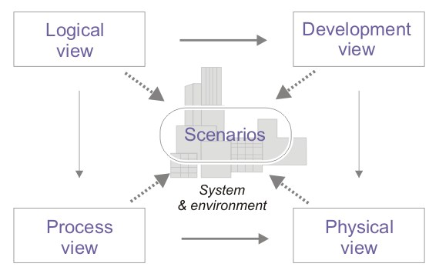
4+1 Model by Krutchen (1995)
Notes:
The “4+1” view model organizes a description of software architecture using 5 concurrent views, each of which addresses a specific set of concerns. Architects capture their design decisions in four views and use the fifth view to illustrate and validate them.
There are five views in the model: the logical view, the process view, the development view, the physical view, and the user interface view.

Slide 20
The Logical or Conceptual View
The view basically is an abstraction of the system's functional requirements
It specifies system decomposition into conceptual entities (objects), and connection between them (associations)
The logical view is supported by UML diagrams such as class, sequence diagram, state, and activity diagram
The stakeholders of the logical view are the end-user, analysts, and designers

Slide 21
The Development or Module View
The development view describes the software static organization of the system modules, which it’s derived from the logical view
Modules such as namespaces, class library, sub-system, or packages are building blocks that group classes for further development and implementation
This view addresses the sub-system decomposition and organizational issue
UML package diagrams are used to support this view
The stakeholders of this view can be programmers and software project manager

Slide 22
The Process View
The process view focuses on the dynamic aspects of the system, i.e., its execution time behavior
This view is an abstraction of processes or threads dealing with process synchronization and concurrency
It contributes to many non-functional requirements and quality attributes such as scalability and performance requirements
The UML activity diagram support this view
The stakeholders of this view are the developers and integrators
Many architectural styles such as pipe & filter, multi-tier, and others can be applied in the process view

Slide 23
The Physical View
The physical view describes installation, configuration, and deployment of the software application
It concerns itself with how to deliver the deployable system
The physical view shows the mapping of software onto hardware
It is particularly of interest in distributed or parallel systems
UML deployment diagram support this view
The stakeholders of this view are system installers, system administrators, system engineers, and operators
Notes:
The components are hardware entities (processors), and the links are communication pathways; these together specify how the various elements such as communication protocols and middleware servers found in the logical, process, and development views are mapped onto the various “nodes” in the runtime environment.
A physical view also considers the system's nonfunctional requirements such as system availability, reliability (fault-tolerance), throughput performance, scalability performance, and security.
For example, software can be delivered in different hardware and networking layouts which will result in significant differences in terms of these quality attributes.

Slide 24
The scenario view
The scenario view describes the functionality of the system
This view provides a foundation for other 4 views and lets them work together seamlessly and coherently
It helps designers discover architectural elements during design and helps to validate the architectural design afterward
The scenario view helps to make the software architecture consistent and validated against functional and non-functional requirements
This view may be provided as a series of screen snapshots or a dynamic, interactive prototype demo or wireframe diagram

Slide 25
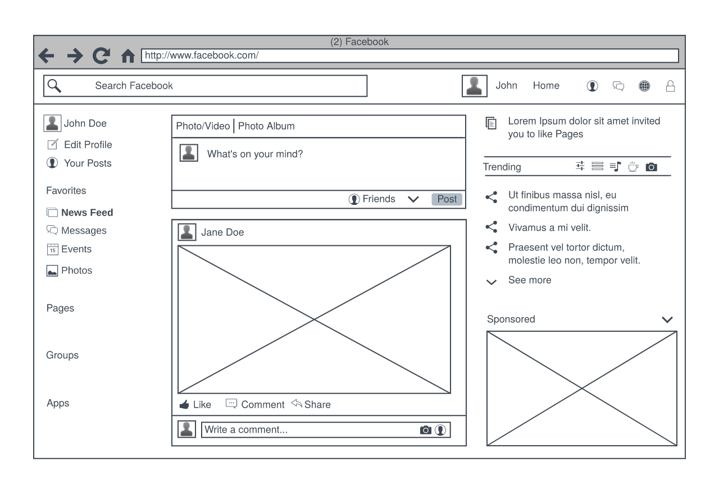
Wireframe diagram example:

Slide 26
4+1 View Summary
The view is an architecture verification technique for studying and documenting software architectural design
Each view provides a window for the different aspects of the system
It covers all aspects of a software architecture for all stakeholders
The views are interconnected; thus, based on the scenarios view, we can start with logical view, and then move to development or process view and, finally go to physical view
The user interface view is also established during this process

Slide 27
References
Chapter 3. Qian, Kai, et al. Software architecture and design illuminated. Jones & Bartlett Learning, 2010
P. B. Kruchten, "The 4+1 View Model of architecture," in IEEE Software, vol. 12, no. 6, pp. 42-50, Nov. 1995
https://www.uml.org/

Slide 28
Appendix A. UML diagrams

Slide 29
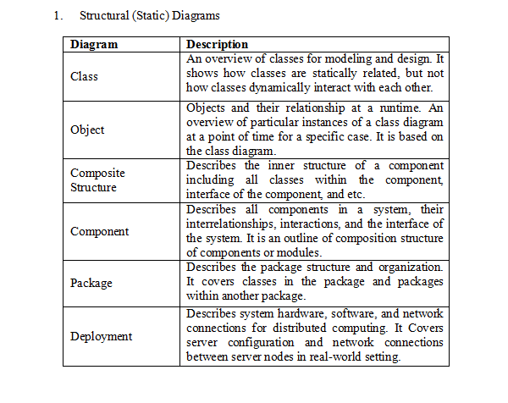

Slide 30
